Slide 1

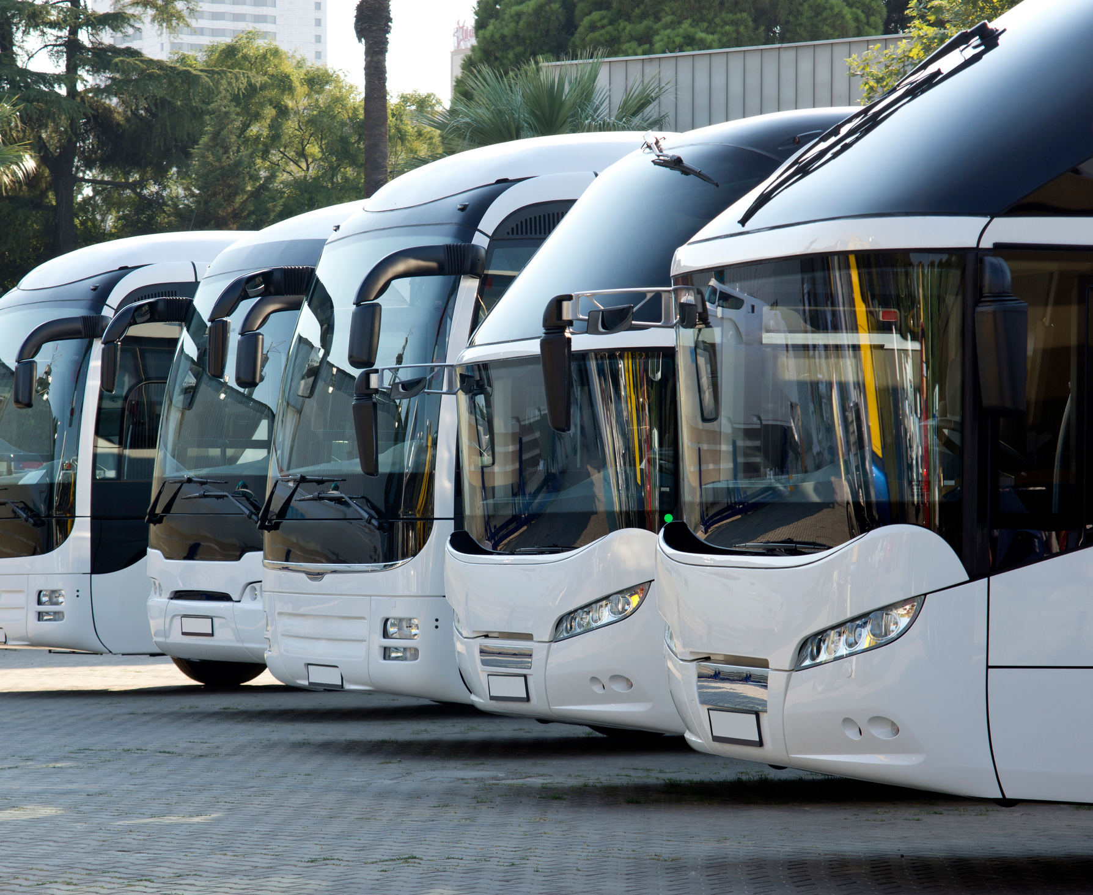

Transport Management System
Muhammad Sohaib
SP22-BCS-057
Database Systems
Instructor: Dr. Umer Rashid

Slide 2
Introduction
Overview: Comprehensive Coordination, Operational Streamlining, Enhanced Efficiency and Experience
Objectives: Streamline transport operations, improve efficiency, enhance customer experience
Importance: Efficient management of vehicles, drivers, and routes

Slide 3
Database Schema Overview
ENTITIES:
Vehicle
Schedule
Route
Passenger
Driver
Booking
Normalized Database (3NF)

Slide 4

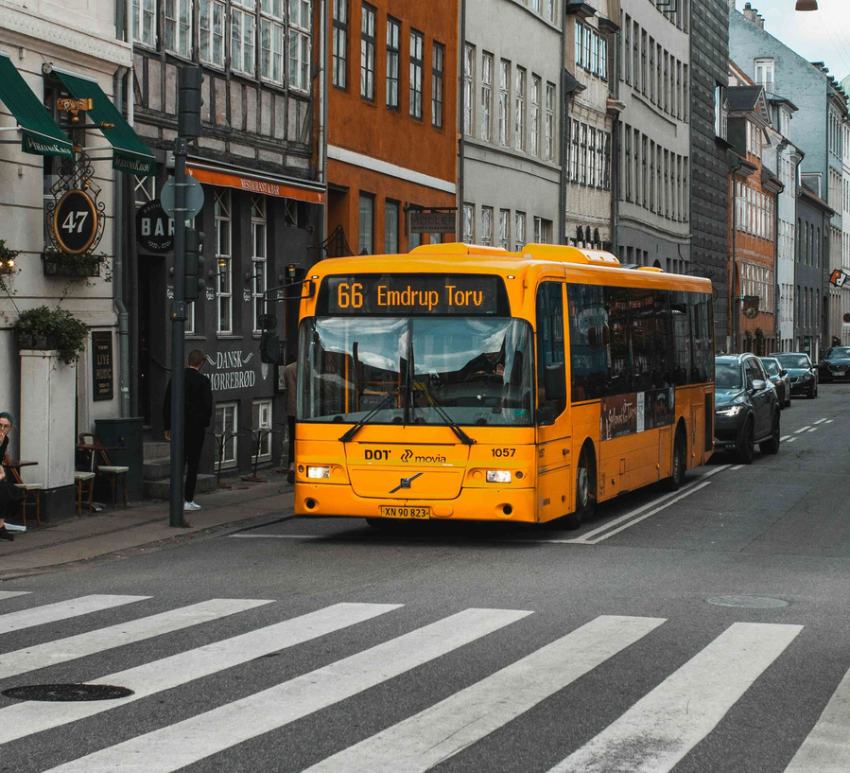
Attributes:
VehicleID: INT, Primary Key, Auto-increment
RegistrationNumber: VARCHAR(20), Unique, Not Null
VehicleType: VARCHAR(50)
Capacity: INT
Status: VARCHAR(20), Not Null, Check constraint (active, maintenance)
Use Cases:
Managing vehicle details
Tracking vehicle status
1st Entity:
VEHICLE

Slide 5
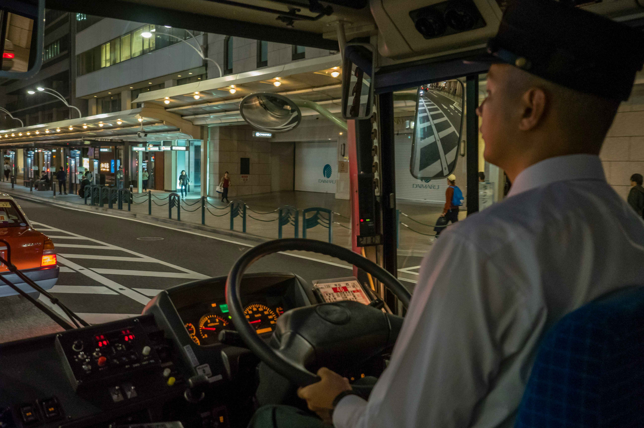
Attributes:
DriverID: INT, Primary Key, Auto-increment
Name: VARCHAR(100), Not Null
LicenseNumber: VARCHAR(20), Unique, Not Null
ContactInfo: VARCHAR(100)
Status: VARCHAR(20), Not Null, Check constraint (available, on leave)
Use Cases:
Storing driver information
Monitoring driver availability
2nd Enitity:
DRIVER

Slide 6

Attributes:
RouteID: INT, Primary Key, Auto-increment
StartLocation: VARCHAR(100), Not Null
EndLocation: VARCHAR(100), Not Null
Distance: FLOAT
EstimatedTime: TIME
Use Cases:
Defining travel routes
Estimating travel time and distance
3rd Entity:
ROUTE

Slide 7
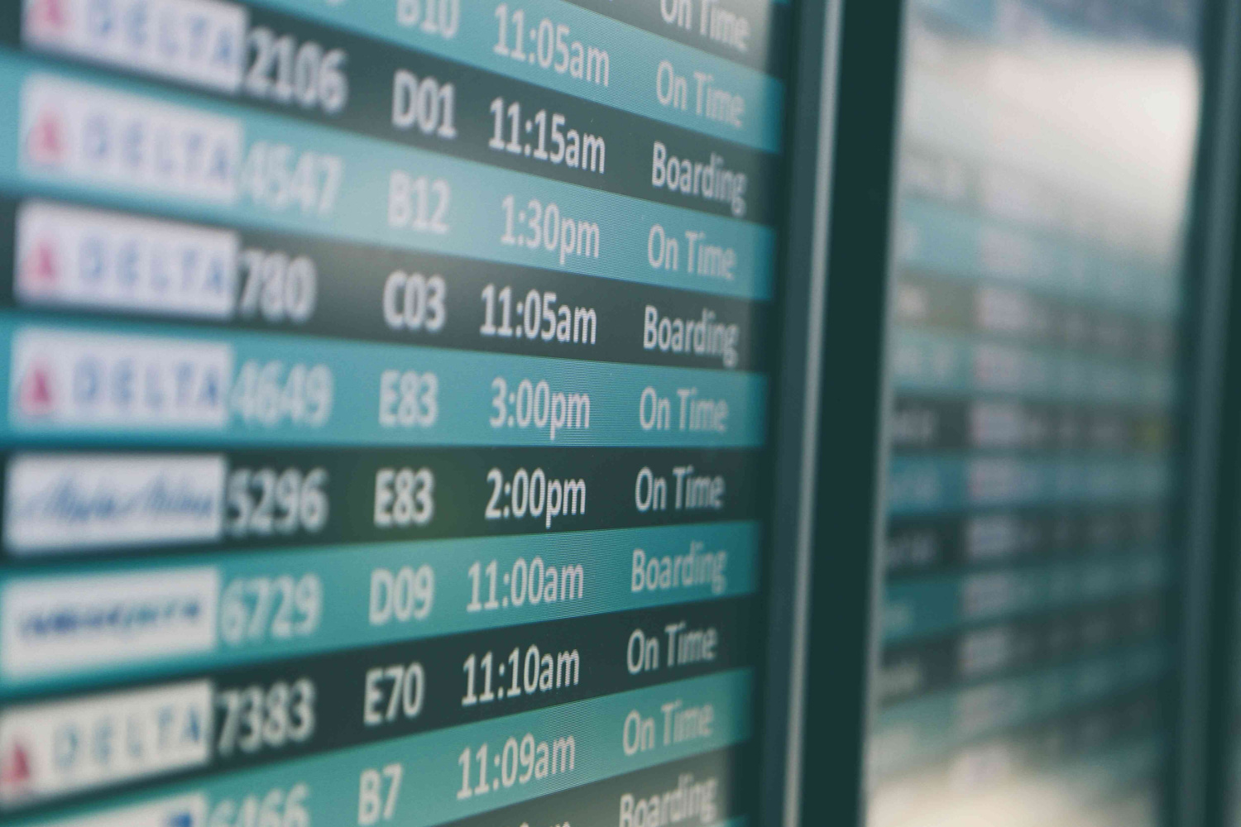
Attributes:
ScheduleID: INT, Primary Key, Auto-increment
RouteID: INT, Foreign Key
VehicleID: INT, Foreign Key
DriverID: INT, Foreign Key
DepartureTime: DATETIME
ArrivalTime: DATETIME
Use Cases:
Scheduling trips
Associating routes with vehicles and drivers
4th Entity:
SCHEDULE
Foreign Key Constraints:
RouteID references Route (RouteID)
VehicleID references Vehicle (VehicleID)
DriverID references Driver (DriverID)

Slide 8

Attributes:
PassengerID: INT, Primary Key, Auto-increment
Name: VARCHAR(100), Not Null
ContactInfo: VARCHAR(100)
Use Cases:
Managing passenger details
Contacting passengers if needed
5th Entity:
PASSENGER

Slide 9

Attributes:
BookingID: INT, Primary Key, Auto-increment
ScheduleID: INT, Foreign Key
PassengerID: INT, Foreign Key
BookingTime: DATETIME
SeatNumber: INT
PaymentStatus: VARCHAR(20), Not Null, Check constraint (pending, completed)
Use Cases:
Recording booking details
Tracking payment status
6th Entity:
BOOKING
Foreign Key Constraints:
ScheduleID references Schedule (ScheduleID)
PassengerID references Passenger (PassengerID)

Slide 10
Unique Constraints
Vehicle Table:
RegistrationNumber: Ensures unique registration numbers
Driver Table:
LicenseNumber: Ensures unique license numbers
Importance:
Ensuring data integrity
Avoiding duplicates

Slide 11
Data Integrity and Constraints
Check Constraints:
Vehicle Status: active, maintenance
Driver Status: available, on leave
Booking Payment Status: pending, completed
Importance:
Ensuring accurate and consistent data

Slide 12
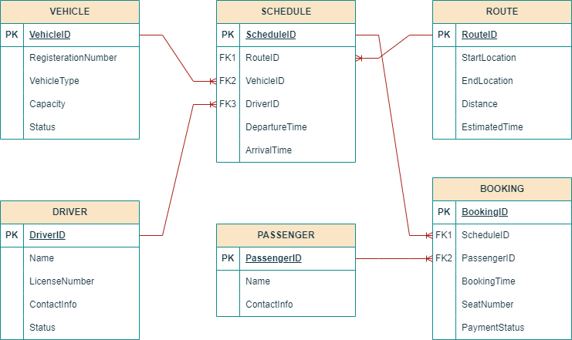

Entity
Relationship
Diagram

Slide 13
Types of Relationships
One Route to Many Schedules: Each route can have multiple schedules.
One Vehicle to Many Schedules: Each vehicle can have multiple schedules.
One Driver to Many Schedules: Each driver can be assigned to multiple schedules.
One Schedule to Many Bookings: Each schedule can have multiple bookings.
One Passenger to Many Bookings: Each passenger can make multiple bookings.

Slide 14
Use Case Scenarios
Examples:
Adding a New Vehicle
Scheduling a Trip
Booking a Seat for a Passenger
Updating Driver Status
Managing Route Changes
Handling Maintenance Requests
Generating Reports and Analytics

Slide 15
Benefits of the Transport Management System
Improved efficiency in managing transport operations
Enhanced tracking of vehicles and drivers
Better customer service through reliable booking and scheduling

Slide 16
Challenges and Future Improvements
Challenges:
Integration complexity
Data accuracy and consistency
User adoption
Future Improvements:
Real-time tracking
Mobile app integration
Predictive analytics

Slide 17

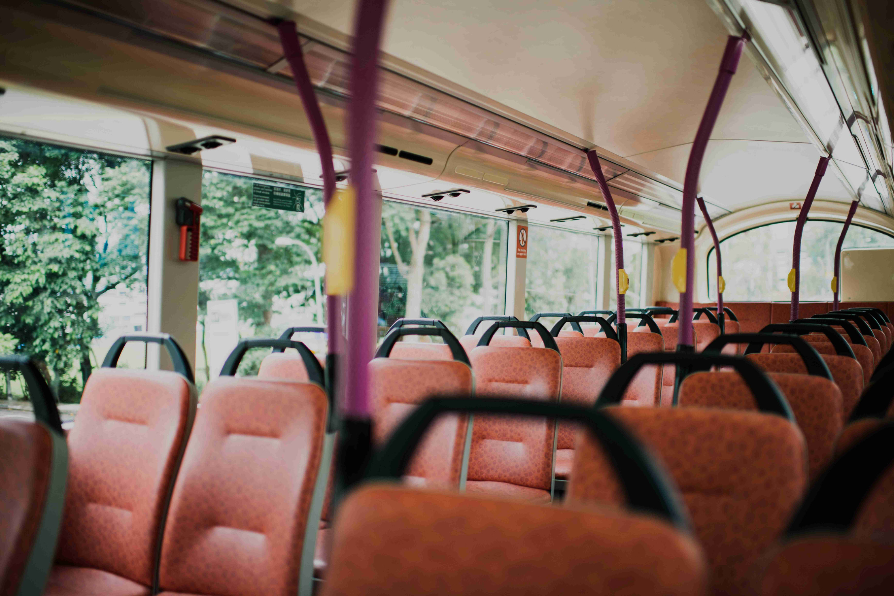


Conclusion
Provides a comprehensive solution for efficient transport operations.
Emphasize the importance of streamlined management of vehicles, drivers, routes, and bookings.

Slide 18
Thank You!
Stay tuned for more!
Contact:
muhammadsohaib800k@gmail.com

